Slide 1

MULTIPLE DISEASE PREDICTION WEB APPLICATION

Slide 2

ABSTRACT
This web application predicts diabetes, heart diseases, and Parkinson's disease using machine learning with Support Vector Machines (SVM) for data training.
Developed with Streamlit, it offers an intuitive interface for users to input health data and receive real-time risk assessments. The application empowers proactive health management through accurate and accessible predictive analytics.

Slide 3

INTRODUCTION
This web application leverages machine learning to predict diabetes, heart diseases, and Parkinson's disease, using Support Vector Machines (SVM) for precise data analysis.
Built with Streamlit, it provides an intuitive platform for users to input health data and obtain real-time risk assessments. The application aims to facilitate early detection and proactive health management through accessible and accurate predictive tools.

Slide 4

LITERATURE SURVEY
Recent studies demonstrate the effectiveness of machine learning, particularly Support Vector Machines (SVM), in predicting diseases like diabetes, heart diseases, and Parkinson's disease.
Streamlit has emerged as a popular framework for developing interactive web applications due to its ease of use.Combining SVM for robust predictive modeling with Streamlit's interface facilitates accessible and accurate health risk assessments.

Slide 5

PROJECT DESCRIPTION
This project involves developing a web application that predicts the risk of diabetes, heart diseases, and Parkinson's disease using machine learning techniques.
Support Vector Machines (SVM) are employed to train the prediction models on extensive health datasets, ensuring high accuracy. Streamlit is used to create an intuitive and interactive user interface, allowing users to input data and receive real-time health risk assessments.

Slide 6
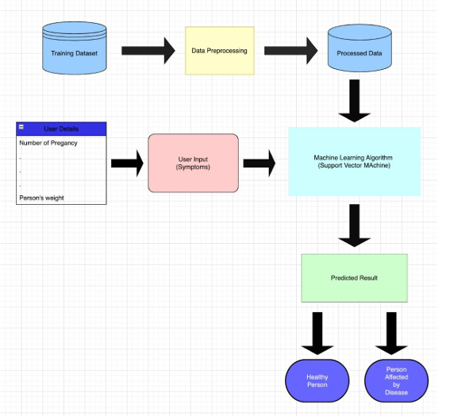
SYSTEM ARCHITECTURE

Slide 7

SUPPORT VECTOR MACHINE
SVM in a multiple disease prediction system transforms patient data into a high-dimensional space to find hyperplanes that best separate different diseases.
It uses approaches like One-vs-Rest or One-vs-One for multi-class classification. The model is trained and evaluated using metrics like accuracy and cross-validation to ensure reliable predictions.

Slide 8
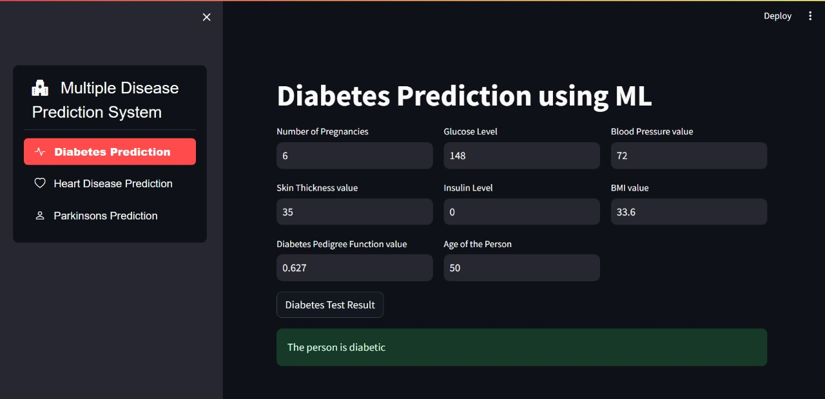
OUTPUTS

Slide 9
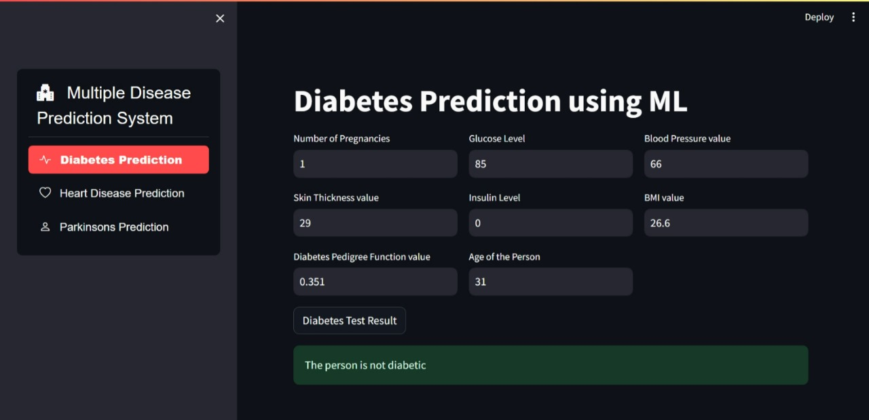
OUTPUTS

Slide 10
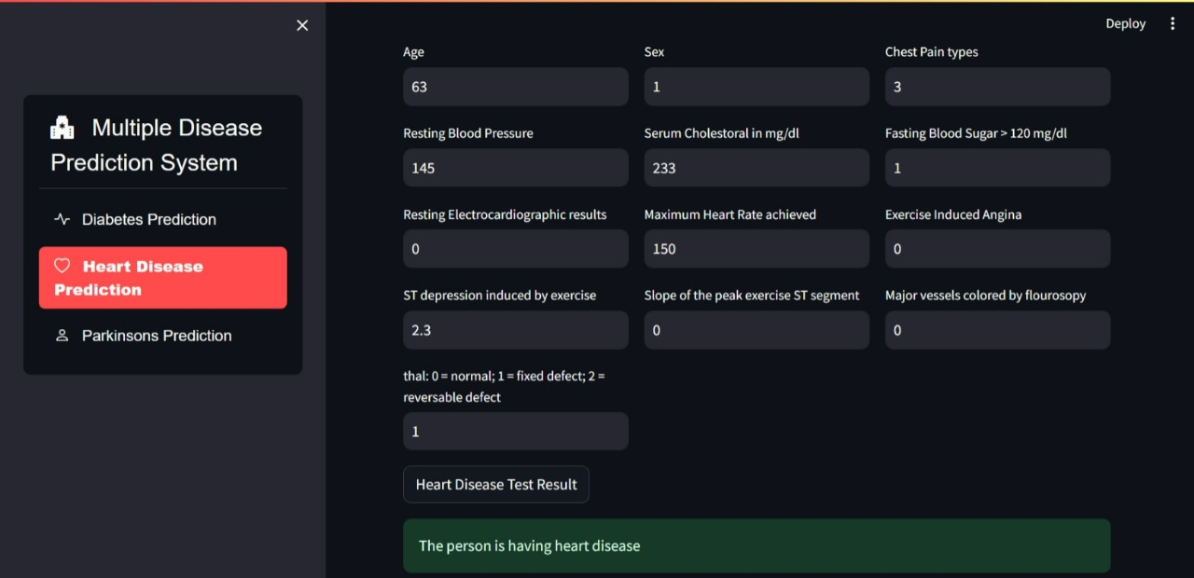
OUTPUTS

Slide 11
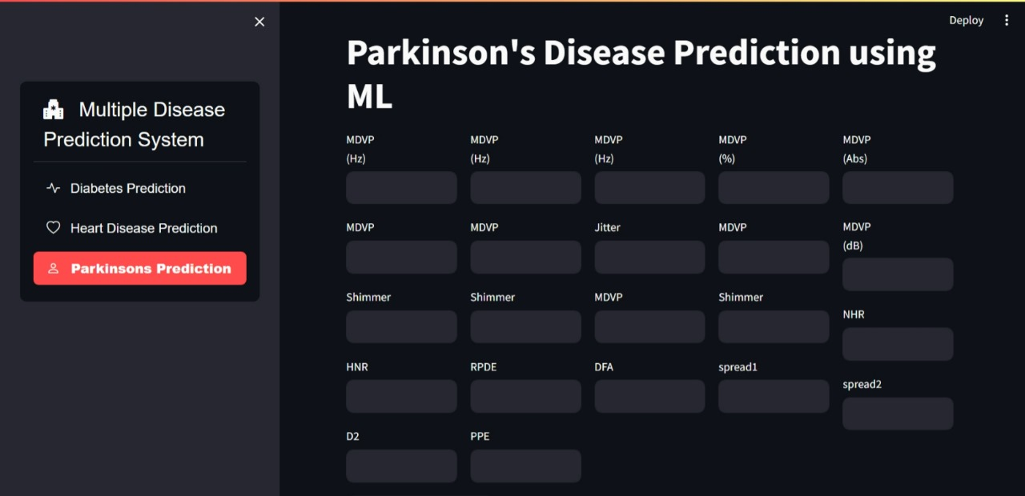
OUTPUTS

Slide 12
CONCLUSION
In conclusion, this web application, utilizing SVM for data training and Streamlit for interface development, offers accessible and accurate predictions for diabetes, heart diseases, and Parkinson's disease.
Its user-centric approach empowers individuals to make informed decisions about their health, fostering proactive management and potentially leading to improved outcomes.

Slide 13

FUTURE ENHANCEMENT
This A future enhancement could involve integrating additional machine learning algorithms alongside SVM to improve prediction accuracy and robustness, thereby enhancing the application's performance across various datasets.
Additionally, implementing personalized health recommendations based on individual risk assessments could further empower users in managing their health proactively.

Slide 14

REFERENCE
Carpinteiro, C., Lopes, J., Abelha, A., & Santos, M. F. (2023, January 1). A Comparative Study of Classification Algorithms for Early Detection of Diabetes. Procedia Computer Science. https://doi.org/10.1016/j.procs.2023.03.117
Guan, Z., Li, H., Liu, R., Cai, C., Liu, Y., Li, J., Wang, X., Huang, S., Wu, L., Liŭ, D., Yu, S., Wang, Z., Jia, S., Hou, X., Yang, X., Jia, W., & Sheng, B. (2023, October 1). Artificial intelligence in diabetes management: Advancements, opportunities, and challenges. Cell Reports Medicine. https://doi.org/10.1016/j.xcrm.2023.101213
Gowthami, S., Reddy, V. S., & Ahmed, M. R. (2024, February 1). Exploring the effectiveness of machine learning algorithms for early detection of Type-2 Diabetes Mellitus. Measurement. Sensors. https://doi.org/10.1016/j.measen.2023.100983

